Slide 1
Steady Improvement
Increasing productivity through a Scrum-Agile Approach

Slide 2
Team Member Roles
Product Owner - Identifies goals and holds responsibility for seeing the backlog is handled by the team. They are also responsible for ensuring they get the best work out of their team. Scrum Master - Their primary focus is to help the team improve effectiveness. This is done through using Scrum practices. Part of that is regular meetings, coaching, assist with planning, and often encouraging communication between teams Development - The people responsible for building the product, testing it and making updates that the product owner and scrum master request. They also take part in planning and design alongside the Scrum Master

Slide 3
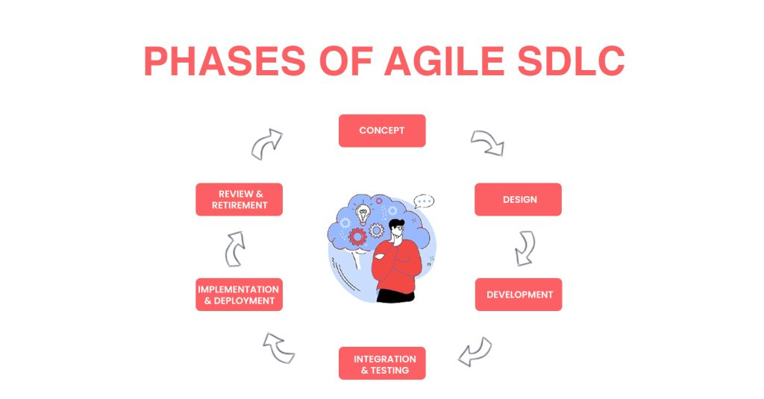
Agile lifecycle
Now we will look at the Lifecycle of the Agile Approach.
Why does it work? How does it improve the process? Can it really improve our product that much?

Slide 4
Steps 1-4
1 - Concept: Gather information and formulate a plan. They discuss what the project goals are and how to solve them.
2- Design: The project outline is presented to the development team. Working with the project owner the team will form plans around programming language to use, how to make it functional, and a basic layout of how the program will be developed.
3 - Development: The development team creates the product as outlined in the previous phases. This is where the initial components are made, servers setup, testing plans created, and finally user stories are taken into account to improve the product
4 - Integration and Testing: During this phase the development that happened is put to the test. The testing team seeks out bugs, inefficiencies, and tries every test case they can to ensure that the code does not have any inherent issues.

Slide 5
Steps 5, 6 and conclusion
5 - Implementation and Deployment: This is the stage where the product is finally deployed. Right before the deployment is launched there is the matter of setting the databases, servers, and hardware that it will all run on.
6 - Review and retirement: This is the final stage. Here is where the project goes through maintenance. Whenever updates happen, or changes need to made to the project the project starts over from the beginning, but this time adding onto the existing project. The retirement refers to when the project is no longer viable to maintain.
Conclusion: Ultimately the Agile process is all about building on, and improving what has happened already. It is full of planning before acting, then reviewing ways to improve what had not worked or what had not. This sometimes takes more time, but more often produces a better product that is easier to maintain.

Slide 6
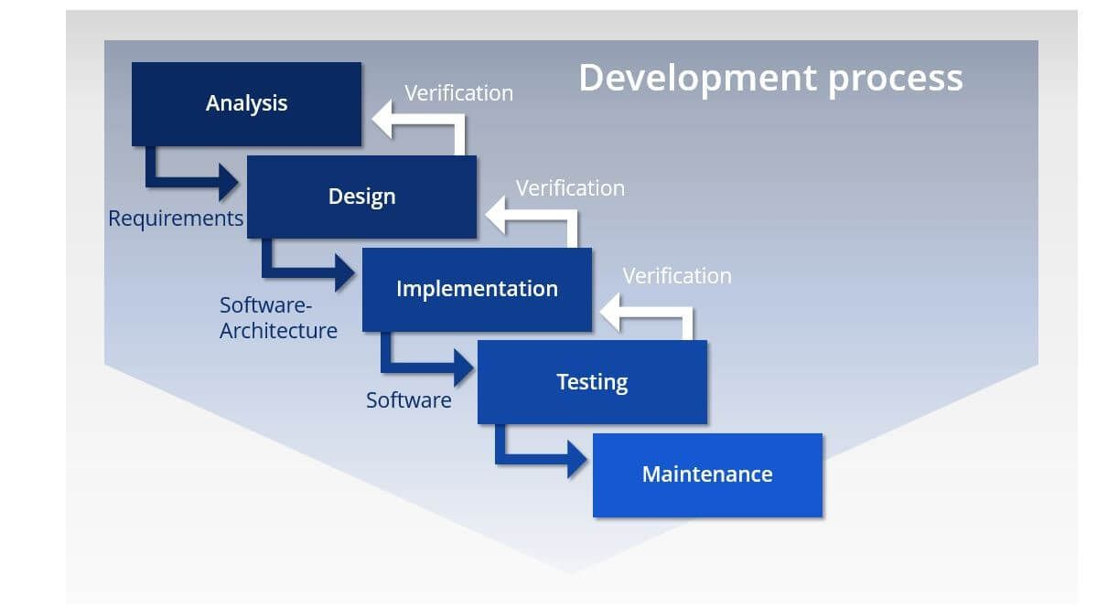
Waterfall Lifecycle
Requirements: This stage is where the team reviews what the customer is requiring.
Design: In this phase the team comes up with or outlines a design plan, detailing language, server types, logical design and so on.
Implementation: This is where the development team produces code.
Verification: The testing phase where the team checks and verifies that the code is viable for release.
Maintenance: during this phase the team make updates and changes as the systems it work with are updated.
Conclusion: The waterfall method has its perks and is still widely used. It is a useful linear model especially with certain types of smaller projects

Slide 7
How to choose an approach
Agile
Great for adapting to changes
Leads to long term stability
Flexible to changes during the process
Allows for, and encourages customer interaction
Can take an extended period of time
Budgeting for each phase is easy, but much more difficult for the overall project
Waterfall
Easy to onboard new developers
Time for the overall project is easy to predict
Budget is more clear from the start
Linear design system
If an issues arises later, it is much more difficult to resolve
Little to no customer collaboration
Agile excels for larger projects, with it’s ability to adapt and make changes. Waterfall is still useful though, especially for smaller projects. This is simply due to the quick streamline process.

Slide 8
Citations
The 2020 scrum GUIDETM. Scrum Guide | Scrum Guides. (n.d.). Retrieved August 14, 2022, from https://scrumguides.org/scrum-guide.html#team-po
The phases of Agile Software Development Life Cycle & Workflow and Project Management. Bitbytesoft.com. (2022, April 26). Retrieved August 14, 2022, from https://bitbytesoft.com/phases-of-agile-software-development-life-cycle/
ProjectManager. (2022, August 4). Waterfall methodology. ProjectManager. Retrieved August 14, 2022, from https://www.projectmanager.com/guides/waterfall-methodology

